Slide 1
HNDIT1012 Visual Application Programming
Week 3

Slide 2
Events in C#
There are several categories of events in C#.
We are going to focus on some events in the following categories:
Mouse Events
Keyboard Events
Windows Form Events
Timer Events

Slide 3
Some Mouse Events
Event | Description
Click | This event occurs when the mouse button is released, typically before the MouseUp event
MouseClick | This event occurs when the user clicks the control with the mouse.
DoubleClick | This event occurs when the control is double-clicked.
MouseDown | This event occurs when the mouse pointer is over the control and the user presses a mouse button.
MouseEnter | This event occurs when the mouse pointer enters the border or client area of the control, depending on the type of control
MouseMove | This event occurs when the mouse pointer moves while it is over a control.
MouseUp | This event occurs when the mouse pointer is over the control and the user releases a mouse button.
MouseWheel | This event occurs when the user rotates the mouse wheel while the control has focus.

Slide 4
MouseEventArgs Class
Provides data for the MouseUp, MouseDown, and MouseMove events.
A MouseEventArgs specifies which mouse button is pressed, how many times the mouse button was pressed and released, the coordinates of the mouse, and the amount the mouse wheel moved.

Slide 5
Some Properties of MouseEventArgs
Button | Gets which mouse button was pressed.
Clicks | Gets the number of times the mouse button was pressed and released.
Location | Gets the location of the mouse during the generating mouse event.
X | Gets the x-coordinate of the mouse during the generating mouse event.
Y | Gets the y-coordinate of the mouse during the generating mouse event.

Slide 6
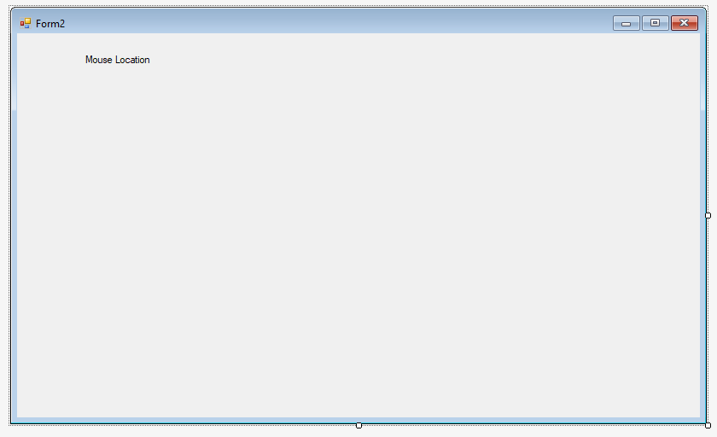
Example
Create a windows form application and place a label on the form as shown below.

Slide 7
Open the property window and select the label to view the properties.
Change the name of the label to “mousePos”.
Select the mouse move event of the form and type the code as shown in the next slide.

Slide 8
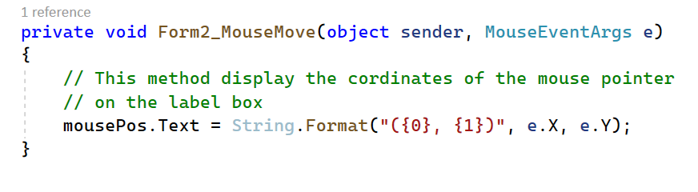
Run the application and view the label while moving the mouse over the form.
This method display the current coordinates of the mouse pointer on the label box.
The MouseEventArgs object e contains all the information about the event such as x and y coordinates, button pressed etc..

Slide 9
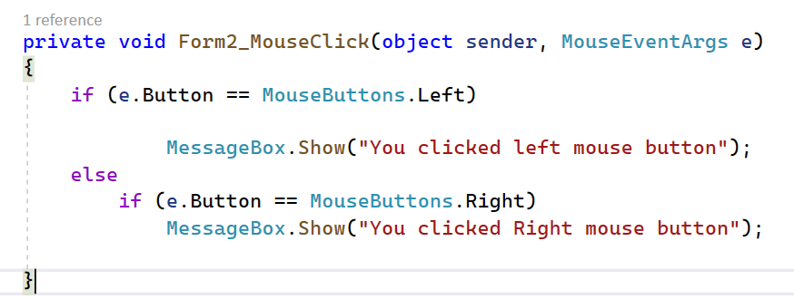
Add the mouseclick event for the form as shown below
Run the project and click on the form by left or right mouse button to view the message box.
MessageBox is used to display any message through a model Dialog.

Slide 10
Keyboard Events
Event | Description
KeyDown | This event is raised when a user presses a physical key. The KeyDown event occurs once.
KeyPress | This event is raised when the key or keys pressed result in a character. The KeyPress event, which can occur multiple times when a user holds down the same key.
KeyUp | This event is raised when a user releases a physical key. The KeyUp event occurs once when a user releases a key.

Slide 11
KeyEventArgs Class
Provides data for the KeyDown or KeyUp event.
A KeyEventArgs, which specifies the key the user pressed and whether any modifier keys (CTRL, ALT, and SHIFT) were pressed at the same time, is passed with each KeyDown or KeyUp event.

Slide 12
KeyPressEventArgs Class
Provides data for the KeyPress event.
A KeyPressEventArgs specifies the character that is composed when the user presses a key. For example, when the user presses SHIFT + K, the KeyChar property returns an uppercase K.

Slide 13
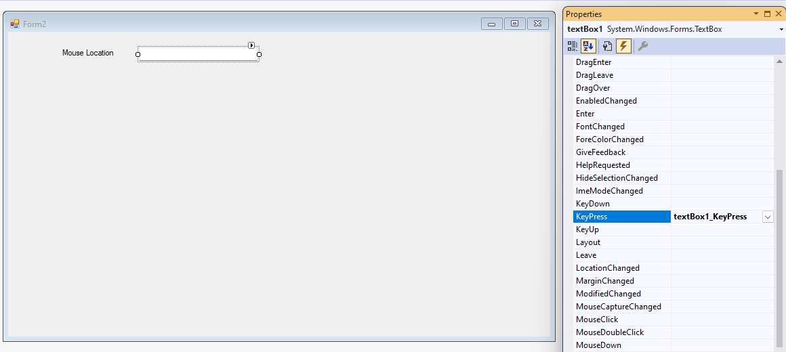
Example
Insert a text box to the form as shown below

Slide 14
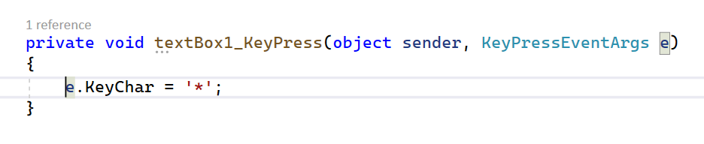
Select the keyPressed method of the textbox1.
Type the code as shown below
Whatever the key user pressed inside the textbox, the character will be replaced by “*”
Run the solution and check the result by typing some text in the text box.

Slide 15
Some Windows Form Events
Event | Description
Form Load | Occurs whenever the user load the form
Form Close | Occurs when the form is closed.
Form Shown | Occurs whenever the form is first displayed.

Slide 16
Timer Event
Event | Description
Tick | Occurs when the specified timer interval has elapsed and the timer is enabled.
Elapsed | Occurs when the interval elapses.
Timer.Interval Property
The time, in milliseconds, between Elapsed events. The value must be greater than zero, and less than or equal to Int32.MaxValue. The default is 100 milliseconds.
Timer.Enabled Property
Gets or sets a value indicating whether the Timer should raise the Elapsed event.
True if the Timer should raise the Elapsed event; otherwise, false. The default is false.

Slide 17
Example
Insert another label to the form and change the properties as shown below:
Name : lblDanger
Text : DANGER
Background color : Red
Foreground color : Yellow
Insert a timer and set the timer properties as shown in the next slide.

Slide 18
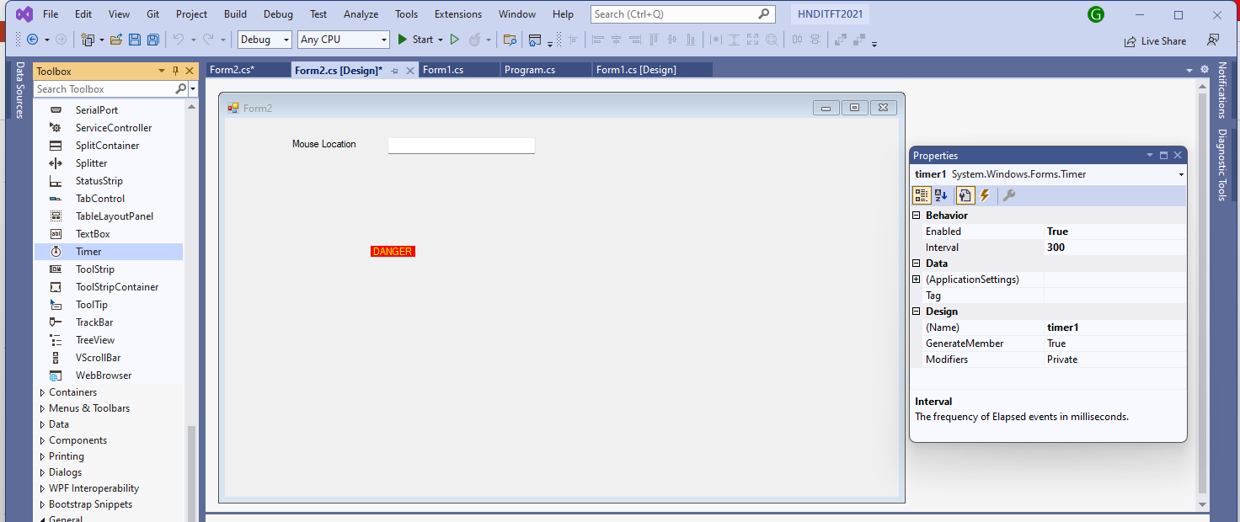
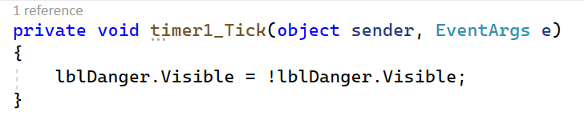
Double click on timer1 to open the tick event and type the code as shown below:

Slide 19
Run the programe to view the blinking DANGER label.
Visible property will be complemented for every 300 milliseconds. ( visible property will switch the values true and false for every 300 milliseconds)

Slide 20
Thank You

